Slide 1
Business Analytics Models
Descriptive Analytics
Predictive Analytics
Prescriptive Analytics

Slide 2
Cluster Analysis
Identify groups of similar elements

Slide 3

Natural and Organic Products are an $81B Industry in The United States
Information Resources Inc. (2012)
Notes:
http://www.amittenfullofsavings.com/wp-content/uploads/2012/05/organic-coupons2.jpg

Slide 4

Segmentation of the Natural/Organic Products Market
5000
Survey Participants
Notes:
Image: http://www.franklinchronicles.com/chronicles/

Slide 5

Seven Segments
True Believers
Enlightened Environmentalists
Strapped Seekers
Healthy Realists
Indifferent Traditionalists
Struggling Switchers
Resistant Non-believers
Notes:
Image: http://www.smartinsights.com/social-media-marketing/social-media-strategy/ssegmentation-technique-for-social-media-marketing/

Slide 6
Which Segments are Good Targets?
Key segments make up just 18% of all consumers but drive almost half of the sales.

Slide 7


Key Targets
True Believers are passionate about staying fit and healthy.
Enlightened Environmentalists are passionate about the environment and about making good choices to preserve it.
Notes:
http://www.admnational.com/lifestyle
http://economicstudents.com/2014/04/why-an-environmentalist-should-befriend-an-economist/

Slide 8


Strong Target
Strapped Seekers believe in and seek natural products when their budget allows it.
Healthy Realists are passionate about being fit but find it difficult deciding whether to buy healthy or traditional products.
Notes:
http://www.europarl.europa.eu/news/en/news-room/20131112IPR24403/EU-budget-2014-Parliament-and-Council-strike-a-deal
http://accesshealthchiro.com/7-foods-to-give-up/

Slide 9



Not All Segments are Worth Pursuing
Indifferent Traditionalists aren’t likely to buy natural/organic products as they see no reason to change.
Struggling Switchers know they should lead a healthier lifestyle but know that low price is a priority.
Resistant Non-believers prefer to stick to the tried and true options they know their families accept.
Notes:
http://nvrap.com/changing-difficult-and-necessary/
https://www.slumber-inn.com/hotels-in-harrisonville-missouri/category/blog/
http://www.planetciancio.com/

Slide 10



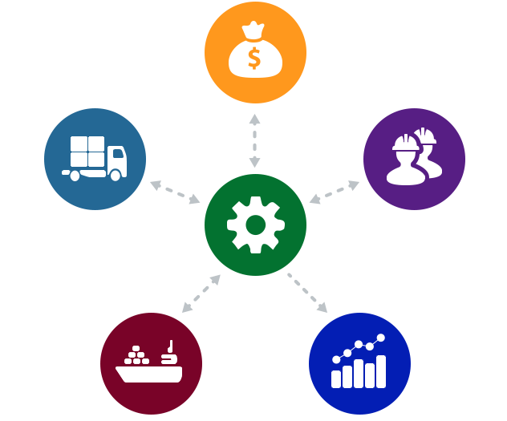
Additional Applications of Cluster Analysis
Product segmentation
Human resources
Price segmentation
Operations management
Notes:
https://vitowe.wordpress.com/
http://www.liftpointconsulting.com/want-to-raise-prices-customer-segmentation-provides-an-answer/
http://human-resources.pusd.schoolfusion.us/modules/groups/integrated_home.phtml?gid=938658&sessionid=bd0ad765bda9613adf03ba3d7eeb2264
http://www.pulsemining.com.au/software/details/operations

